Slide 1
INOVAÇÃO, EMPREENDEDORISMO E TRANSFERÊNCIA DE TECNOLOGIA
FCUL – 2018/2019
Mestrado em Microbiologia
IST/FCUL
AULA 1
18 Setembro 2018
Helena Vieira
Copyright ©

Slide 2
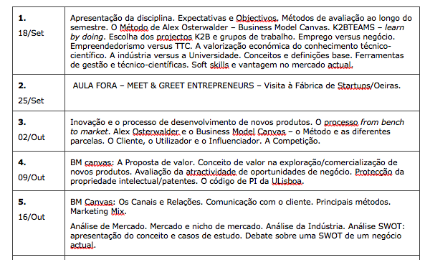
Programa (1)

Slide 3
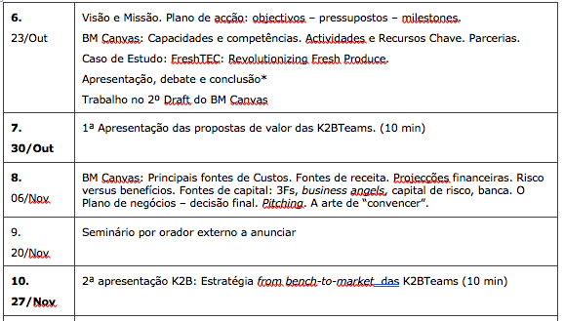
Programa (2)

Slide 4
Programa (3)

Slide 5
HOW WILL WE TEACH YOU?
LEARNING BY DOING Methodology
Story Telling & Inspirational Teaching
Challenges & Gamification (yep, competition will occur!)
YOU = MINI ENTREPRENEURIAL IMMERSIVE EXPERIENCE (K2B)

Slide 6
BOOKS YOU SHOULD CHECK
Clark, T., Osterwalder, A. e Pigneur, Y (2009), “Business Model Generation”. Self Published. ISBN:978 2 8399 0580 0.
Osterwalder, A., et al. (2014), “Value Proposition Design”
Clark, T., Osterwalder, A. e Pigneur, Y (2012), “Business Model You”
Steve Blank. (2013). The four steps to Epiphany. Self Published. ISBN: 0 989 200 507.
Eric Ries. (2011). The Lean Startup: How Today's Entrepreneurs Use Continuous Innovation to Create Radically Successful Businesses. Crown Business, USA. ISBN 978-0-307-88789-4.
Biodesign Website: http://www.stanford.edu/group/biodesign/cgi-bin/ebiodesign/
Ambrose, G. e Harris, P. (2009), “Basics Design 08: Design Thinking”, AVA Publishing SA
Blank, S. e Dorf, Bob (2012), “The Startup Owner’s Manual: The Step-By-Step Guide for Building a Great Company”, K & S Ranch
Campinos, A., et al. (2010), "Código da Propriedade Industrial - Anotado", Almedina
Entrepreneurship Monitor – GEM Portugal 2014
Ernest & Young (2011), “Nature or nurture DNA”
Glei, Jocelyn K. (2014), “Make your Mark: The Creative’s guide to building a business with impact”, Amazon Publishing
Hoffman, R. e Casnocha, B. (2012), “The startup of you: Adapt to the Future, Invest in Yourself, and Transform your Career”, The Alliance
Kawasaki, G. (2004) “The Art of the Start: The Time-Tested, Battle-Hardened Guide for Anyone Starting Anything”
Kelley, T., Littman, J. e Peters, T. (2001), “The Art of Innovation - Lessons in Creativity from IDEO, America's Leading Design Firm”, Profile Business
Mota, A., e Custódio, C. (2006), “Finanças das Empresas”, Booknomics
Rede ETC - Universidade de Lisboa (2014), "Princípios Gerais e Carta de Boas Práticas"
Regulamento de Propriedade Intelectual da Universidade de Lisboa
Rocha, M. e Carreiro, H. (2005), "Guia da Lei do Direito de Autor na Sociedade da Informação", Centro Atlântico
Smith, J. e R. Smith (2004, 2ª Ed.), “Entrepreneurial Finance”, Willey
Summers, J. E Smith, B. (2009), “Communication Skills Handbook”, John Willey & Sons Ltd
Timmons, J., A. Zacharakis e S. Spinelli (2004), “Business Plans that Work”, McGraw-Hill
Tzu, S. (1997), “The Art Of War”
Vários Autores (2013), “A Alma do Negócio: Um guia práctico para os empreendedores em Portugal”, Sabedoria Alternativa
WSI (2013), “Digital Minds: 12 Things Every Business Needs to Know about Digital Marketing”, Friesenpress
Young, S. (2012), “The Badass Book of Social Media and Business Communication”, Get in Front Communications, Inc.

Slide 7
LINKS YOU SHOULD CHECK
http://www.businessmodelgeneration.com/canvas/bmc Tools for Business Model Canvas
https://www.entrepreneur.com/magazine Entrepreneur Magazine
http://www.forbes.com/entrepreneurs/#5ae45ac06ce7 Forbes Magazine Entrepreneur Section
http://www.eofire.com/podcast/ ENTREPRENEUR ON FIRE PODCAST
patentscope.wipo.int/search/en/search.jsf Patente Scope (base de dados do WIPO)
worldwide.espacenet.com/?locale=en_ EP Espacenet (base de dados do EPO)
www.iapmei.pt Instituto de Apoio às Pequenas e Médias Empresas e Inovação
www.inpi.pt Instituto Nacional da Propriedade Industrial (INPI)

Slide 8
HOW WILL WE EVALUATE YOU?
Well… This is still a class and this is still College so we need grades!
Continuous (really!) evaluation = Compulsory presence
Soft skills development – Communication, participation, argumentation & evolution
K2B Project – 3 PITCHs (team)
Individual PITCH (2 min/free subject)
Business SWOT
Case study
Personal SWOT
K2B materials to deliver

Slide 9
K2B PROJECTS
Groups of 4-5 students (different backgrounds advised)
Project focused on your own ideas! (yes, start thinking!)
Goal is to validate idea w/ market directly!
We will use Business Model Canvas Method & Pivoting
Final proposal will be a valid & structured idea with a clear go to market strategy!

Slide 10
K2B projects
Initial Pitch (10 min)
(value proposition, business concept, clarity/focus, passion, innovation, time)
Deliver Value proposition (on closed envelope)
Intermediate Pitch (10 min) (problem, value proposition, business concept, business model, market/industry, cost estimation, team, clarity/focus, passion, innovation, time)
Final Pitch (5 min) (Problem, Value proposition, business concept, business model, market/industry, cost estimation, team, clarity/focus, passion, innovation, time)
Deliver executive Summary & BM Canvas variations + final (one week after end of classes)

Slide 11
K2B Projects
Search
Assess
Test
Propose
R&D

Slide 12
K2B Projects
Study Science
Assess similar projects, possible companies
Contact , contact , contact, people & players
What is your conclusion?
K2B project

Slide 13
K2B Project
Junk
Go back to lab
License out
Spin-off
Very incipient technology
Near the market technology

Slide 14
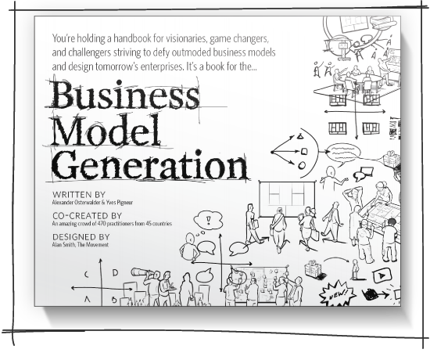
HOW WILL WE GET THERE?
ALEX OSTERWALDER
http://www.businessmodelgeneration.com/book

Slide 15
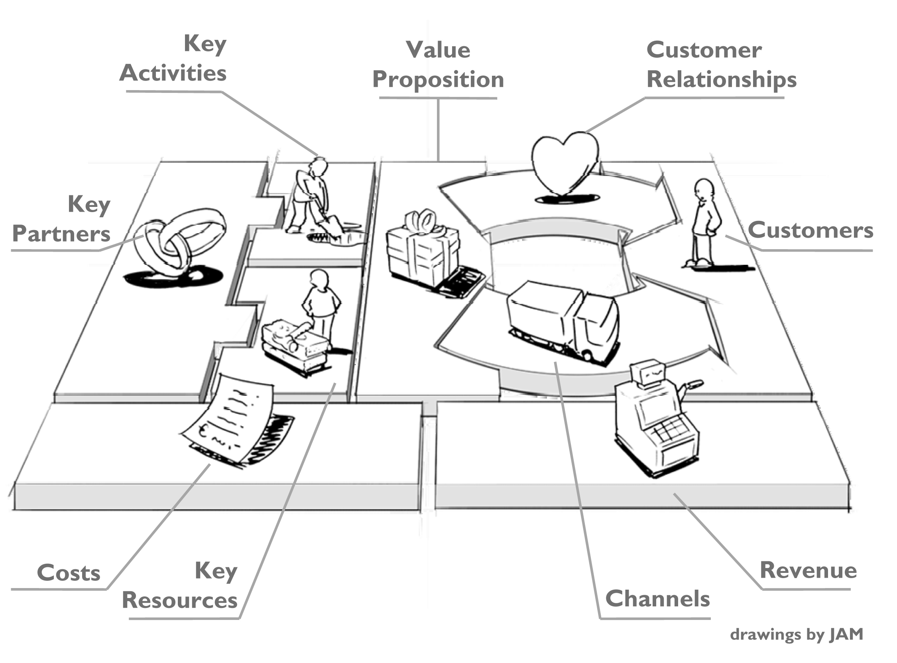
HOW WILL WE GET THERE?
in: Business Model Generation, Alex Osterwalder & Yves Pigneur, 2009

Slide 16
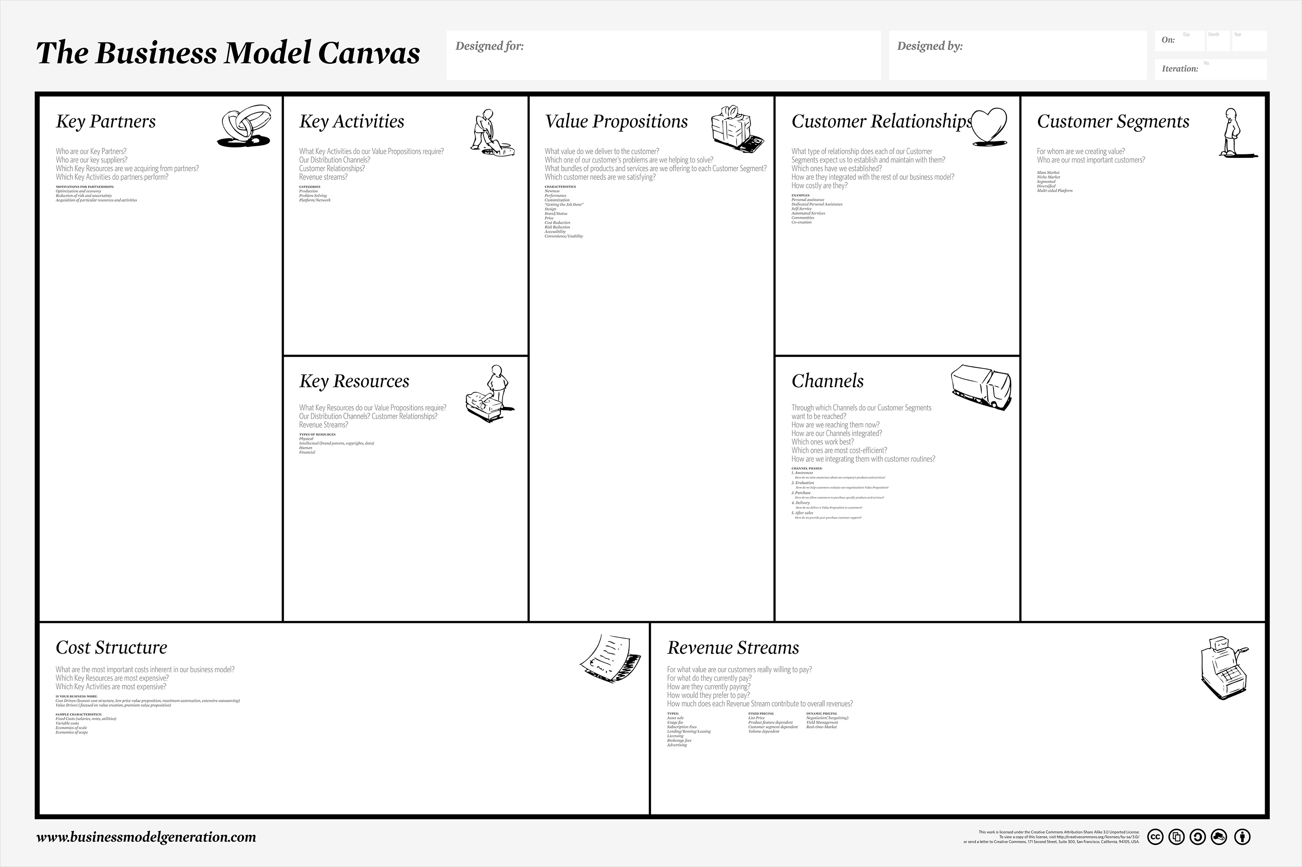
HOW WILL WE GET THERE?
in: Business Model Generation, Alex Osterwalder & Yves Pigneur, 2009

Slide 17
- PhD in Biomedicine in Imperial College of London, UK
University Professor for over 15 years
Lived abroad and traveled over more than 50 countries
Founder and CEO of BIOALVO SA
- Invited Professor at FCUL for Innovation & Entrepreneurship
Executive Post-Graduation in Harvard Business School
Mentor of NATIONAL NETWORK OF MENTOR
- FP7/H2020 Expert for Innovation Calls
- EU and UN Marine Expert
Founded MY.SKINMIX (2016) and UAU HOMES (2017)
Participated in more than 10 BP competitions and accelarators
- Executive Director of BLUEBIO ALLIANCE
WHY ME?…

Slide 18
SO, WHAT ARE YOU THINKING TO DO NEXT?
GET A JOB?
Preferably well paid!!!
Where???
How do you distinguish yourself from the rest of you in this room???

Slide 19
HOW GOOD ARE YOU?

Slide 21
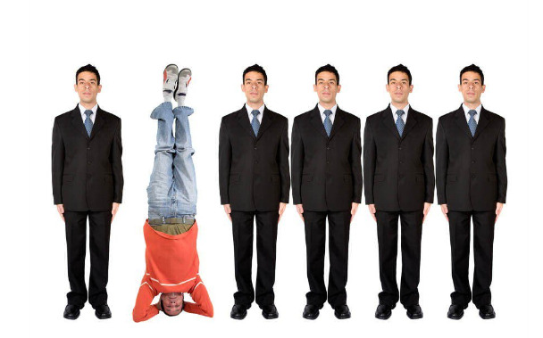

Slide 22
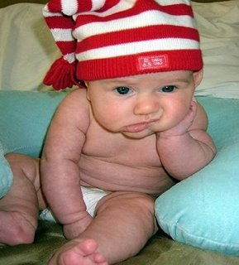
BUT I AM SORRY TO SAY….
There are no JOBS! BUT …
THERE IS A LOT OF WORK TO BE MADE!

Slide 23
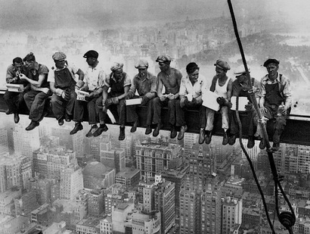
WHAT DO I DO THAT ADDS
REMARKABLE
MEASURABLE
DISTINGUISHED
DISTINCTIVE
VALUE?

Slide 24
PEOPLE THAT KNOW THE WORLD BEFORE THEY “KNOW” WHAT THEY WANT!

Slide 25
IT IS NOT ABOUT YOU ALONE!!
WHAT DO YOU BRING TO YOUR EMPLOYER AND SOCIETY??!!

Slide 26
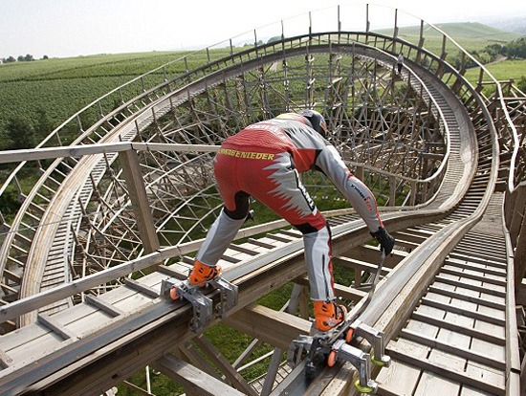
BUT YOU COULD ALSO BECOME AN ENTREPRENEUR?
WHY NOT???
Notes:
SO YOU ARE TOTALLY ARMED TO FACE THE FEAR!

Slide 27
WHAT YOUR COLLEAGUES HAVE TO SAY ABOUT THIS
“This course motivated me to think about my future career and the importance of the start ups. I think that the course was one of the best courses I ever had in my education history. It opened my mind and helped me to developed my soft skills which will be more helpful in my future life than "dry" academic knowledge.” Erasmus Student, IE 2016
“I found this subject the most important of all. Doesn't matter what you study, all of us should complete this subject. The passion of the teacher Is very helpful and motivating. I guess (…) we should have had more meetings with successful entrepreneurs (…). Good job!” Erasmus Student, ITT 2016

Slide 28
WHAT YOUR COLLEAGUES HAVE TO SAY ABOUT THIS
“É de facto uma disciplina que superou as minhas expectativas. Pensei que fosse ser algo do mesmo género a uma cadeira anterior do mesmo tema, mas é bastaste mais educativo. Não é apenas copiar e colar do material apresentado nas aulas, exige mesmo a aprendizagem por nós próprios. Dou por mim a pensar em possíveis ideias de negócio/oportunidades no decorrer do meu dia-a-dia, aliás vou iniciar um pequeno negócio entretanto e espero pôr em prática muitos dos conhecimentos aqui adquiridos. Obrigada.” Master Student, ITT 2016
“A cadeira é muito trabalhosa! Mas mudou a minha vida!” Master Student, TTC 2015
“Adorei, acho que isto é muito mais do que uma cadeira, é uma experiência, Obrigada!” PhD Student, Empreendedorismo 2016

Slide 29
PRECONCEIVED IDEAS
We all have them!
Are they any useful?

Slide 30
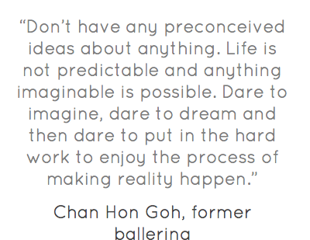

Slide 32
A job is better than starting my business
1st Preconceived idea

Slide 33
Job Vs Business
Someone (employee) that delivers services to another one, either a physical or legal one (employer), in a subordinated way, on a personal basis, recurrently and paid for.
Notes:
Que é o Negócio para voçês?

Slide 34
Job Vs Business

Slide 35
Job Vs Business
WHY?
Levels of Comfort zones (are they really comfortable?)
Financial?
Structural?
Others? Time management?
What are we missing?
Fast learning track
Impact
Power to decide our lives
Notes:
he financial comfort: we had to work hard, so we could justify our pay checks. However, our performance had an effect only on a mid to long term basis, but rarely on a short term basis. The risk was limited, and easily managed.
The process comfort: we were part of a group, an entity, and whether we were a driver or a follower, we did not have to worry night and day about the “what to do?” or the “why do this rather than that?” because it was being expressed and managed collectively.
The time management comfort: this might be the biggest challenge, because you never see the truly positive aspects of office hours until you loose them.
The combination of the three brought a whole new dimension to our professional lives, and clearly challenged our pre-conceived convictions.

Slide 36
Entrepreneurship is not for me!
2nd Preconceived idea

Slide 37
ENTREPRENEURSHIP
WHAT IS IT TO YOU?

Slide 38
ENTREPRENEURSHIP

Slide 39
Entrepreneurship
Entrepreneurship is the practice of starting new organizations or revitalizing mature organizations, particularly new businesses generally in response to identified opportunities. Entrepreneurship is often a difficult undertaking, as a vast majority of new businesses fail. Entrepreneurial activities are substantially different depending on the type of organization that is being started. Entrepreneurship ranges in scale from solo projects (even involving the entrepreneur only part-time) to major undertakings creating many job opportunities
(source: wikipedia)
Entrepreneur: the art of taking something at risk
Notes:
A largely held view of the term is that an Entrepreneur is the person who brings about a change and possesses characteristics to implement ideas to benefit the society as a whole. Only a few people are talented enough to manage this change. Apart from this definition, a simple explanation of the term ?Entrepreneurship? is that it is the person who wants to work for himself.

Slide 40
Entrepreneurship
Entrepreneurship – the pursuit of opportunity beyond the resources one currently has under control (source: Berkley, 2006)
Management process NOT only an individual characteristic

Slide 41
The Process of Entrepreneurship
Identify
Need
Solution Opportunity
Unfair advantage
Acquire
Technology rights
People Resources
Money

Slide 42
ENTREPRENEURSHIP
DO WE NEED SPECIAL PERSONALITY TRAITS?
OR
CAN THEY BE DEVELOPED?

Slide 43
Entrepreneurs
Notes:
O Empreendedorismo pode ser intra ou inter

Slide 44
ENTREPRENEURSHIP
CAN YOU NAME YOUR FAVOURITE ENTREPRENEUR?

Slide 45
TYPES OF ENTREPRENEURSHIP
INTRAPRENEURSHIP
ECONOMIC
SOCIAL
Notes:
What are they and how do they differ?
Can you name examples?
INTRAPRENEURSHIP – VINHO D’AGUA Casa Ervideira
ECONOMIC – UNIPLACES
SOCIAL - Ocean Sole

Slide 46
Startups are small companies
3rd Preconceived idea

Slide 47
STARTUP Vs SME
Are they the same?
Is a Startup a company?

Slide 48
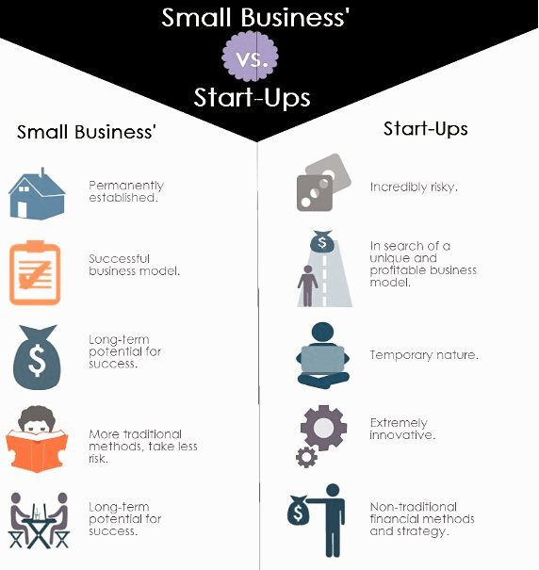

Slide 50
Innovation is just a fancy name!
4th Preconceived idea

Slide 51
INNOVATION
INVENTION
+
EXPLOITATION
=

Slide 52
INNOVATOR + ENTREPRENEUR
http://www.youtube.com/watch?v=lZKhZmvJuZY

Slide 53
INNOVATION
More detail to come next week!

Slide 54
Technology transfer is a cool technology!
5th Preconceived idea

Slide 55
Technology Transfer
Technology transfer is the process of sharing skills, knowledge, technologies, methods of manufacturing, samples of manufacturing and facilities among governments and other institutions to ensure that scientific and technological developments are accessible to a wider range of users who can then further develop and exploit the technology into new products, processes, applications, materials or services.

Slide 56
Technology Transfer
Can be done in different formats/values
Entrepreneurial (Economic Valorization)
Altruíst (Scientific Dissemination of Knowledge)
How Should we (Must we) see Science?
Notes:
Qual a Vossa precepção da ciência que fazem?
Qual a percepção que têm da percepção dos outros e do público generalista?

Slide 57
Technology Transfer

Slide 58
Technology Transfer
Constituents of Technology Transfer Processes
Technology Transfer
Technology Promotion
Technology Deployment
Technology Innovation
Technology Development
Technology Research
Technology Assessment
Technology Information and communication
Technology Investment
Technology Collaboration
Technology Commercialization

Slide 59
Does knowledge have an economic value?
K2B, I-Teams, BioTeams….
Why?
Option or Duty?
What tools are we missing?
Notes:
Performing opportunity recognition, fostering entrepreneurs, structuring deals, HARVESTING OUTCOMES! Ferramentas:
TTO education
Awareness of opportunity constant search
Dedicated office
Competitions
Learn by doing (use the student force to spread the work)
Go to meetings with potential customers/buyers/VCs
Incentives to Pis – spin-out companies
…

Slide 60
TOOLS WE NEED TO VALUE K
Management
Technical/Scientific
Other?
Atitude?
Soft Skills?
Critical analysis?
Negotiation SKills?
IP?

Slide 61
Industry & Academia are 2 worlds apart!
6th Preconceived idea

Slide 62
Industry Vs University
2 worlds apart?
Rythm?
Focus?
Competencies?

Slide 63
I have all I can when I finish my degree!
7th Preconceived idea

Slide 64
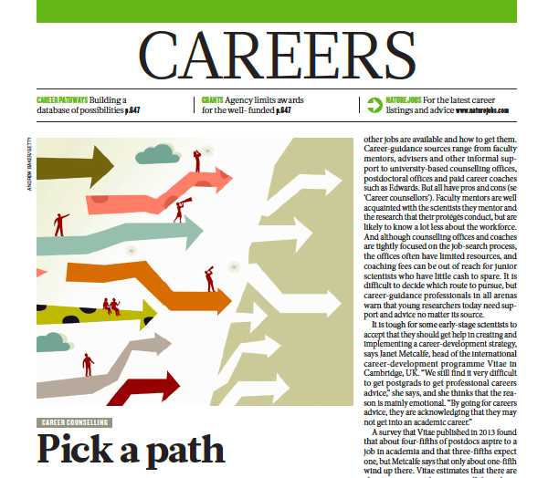
NATURE, Vol. 512, 29th January 2015

Slide 65
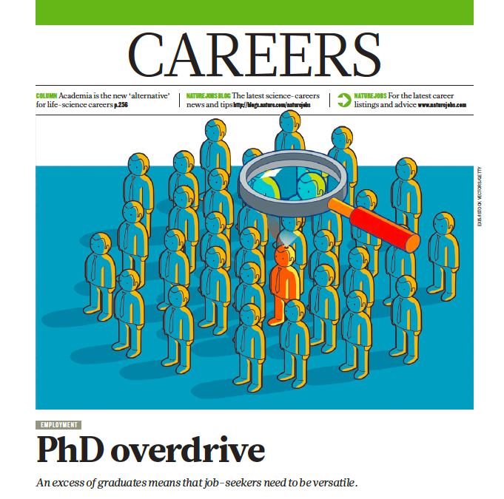
NATURE, Vol. 511, 10th July 2014

Slide 66
SOFT SKILLS = SMART SKILLS
YOU HAVE A PROBLEM:
TECHNICAL COMPETENCES DO NOT LAND YOU A JOB OR GUARANTEE SUCCESS!

Slide 67
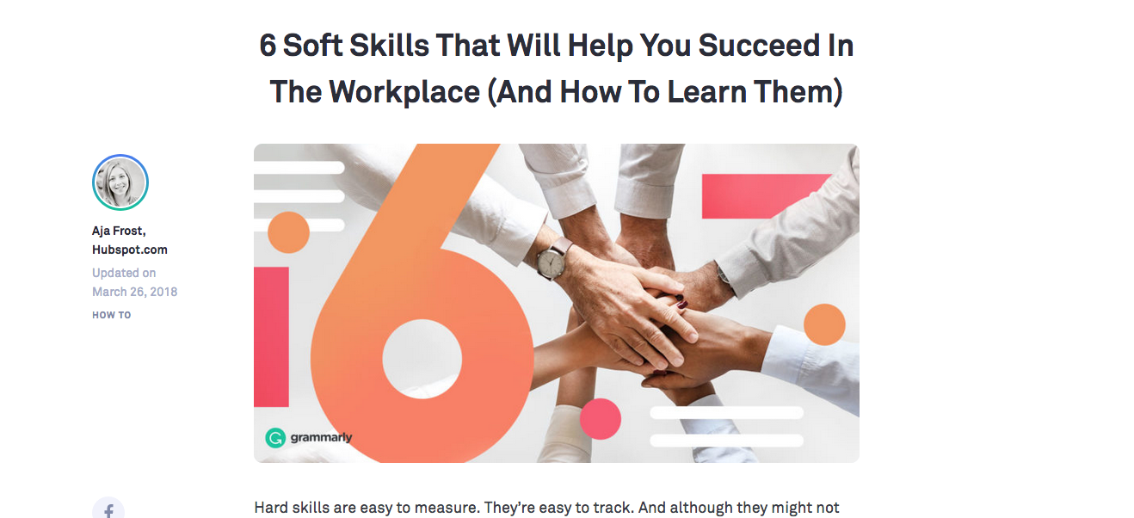
Full article in: https://www.grammarly.com/blog/soft-skills/

Slide 68
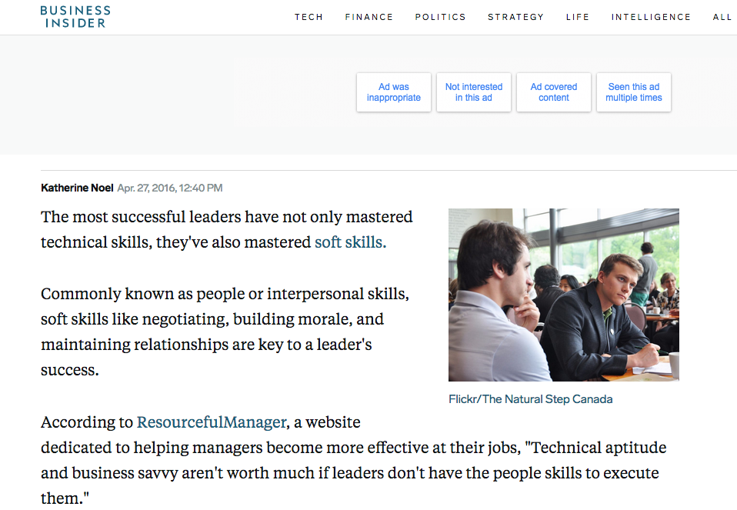
https://www.businessinsider.com/soft-skills-leaders-need-for-success-2016-4

Slide 69
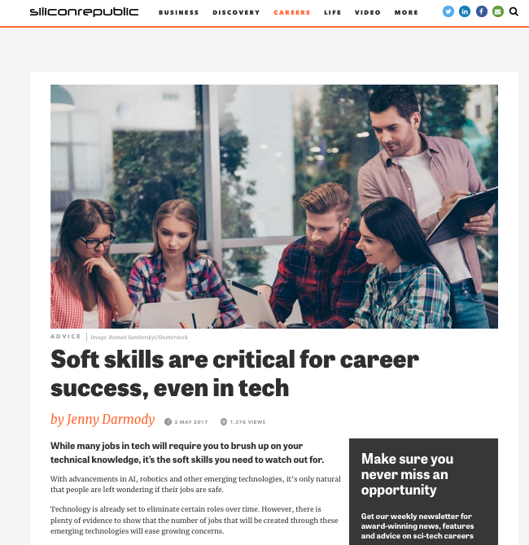
https://www.siliconrepublic.com/advice/soft-skills-career-success

Slide 70
SOFT SKILLS = SMART SKILLS
Major skills employers look for/successful people have:
Know how & technical competencies (25%)
Project management skills (23%)
Top verbal and written communication(15%)
Organizational skills (14%)
Interpersonal relationship skills (13%)
Resilience

Slide 71
SOFT SKILLS = SMART SKILLS
Written Communication
Verbal Communication
Different languages
Management by goals
Emotional Inteligence & Conflict management
Entrepreneurship & Failure management
Leadership and Team management
Critical analysis
Negotiation Skills
Innovation & continuous learning
Knowledge management
K2B e SWOT
K2B, Pitchs & Cases
IETT
IETT
K2B
IETT
K2B
Case Studies
IETT, K2B, Casos
IETT
IETT

Slide 72
SOFT SKILLS = SMART SKILLS
THIS IS WHY WE WILL PUSH YOU OUT OF THE BOX, OUT OF YOUR CONFORT ZONE!
LEARNING BEGINS WHEN YOU FEEL UNCONFORTABLE…

Slide 73
DO YOU THINK I AM CRAZY?

Slide 74
MY CHALLENGE TO YOU!

